Slide 1
Sneaker Hub
SNH
By: Aylin Ignacio & Sareena Grajeda

Slide 2
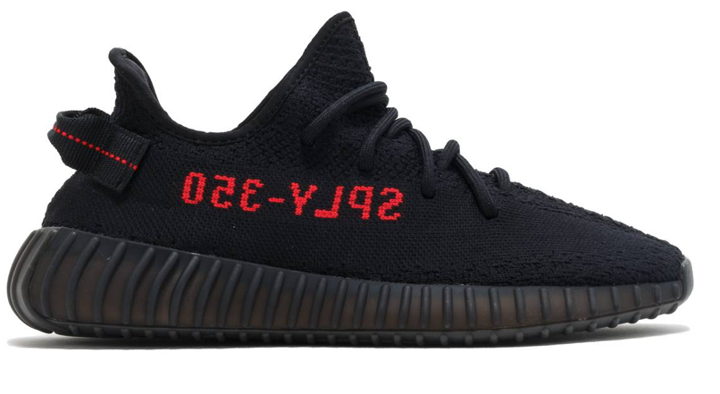
What is Sneaker Hub?
Sneaker Hub is a website created for those who love sneaker shopping. Currently our website host only 3 types of of shoes and 1 shoe brand. We wanted to build a website that contained an interest of ours which was shoes. More specifically Yeezys.
When creating a website like this we want to be able to cater to the needs of those who are also fans of this shoe and whom have very little opportunities to purchase them as they sell out fast.
Sneaker Hub was made for this purpose and we hope you enjoy shopping on our site.

Slide 3
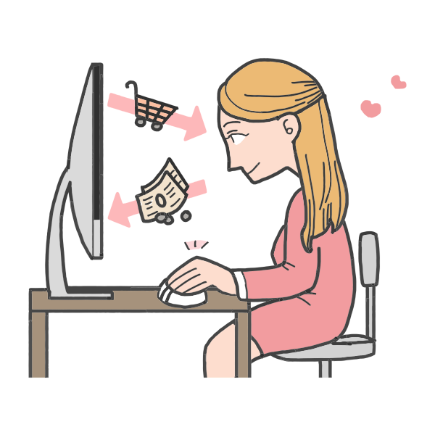
Our Goals
Promote our business for further growth and sales
Provide excellent customer service/experience
Grow as a business

Slide 4
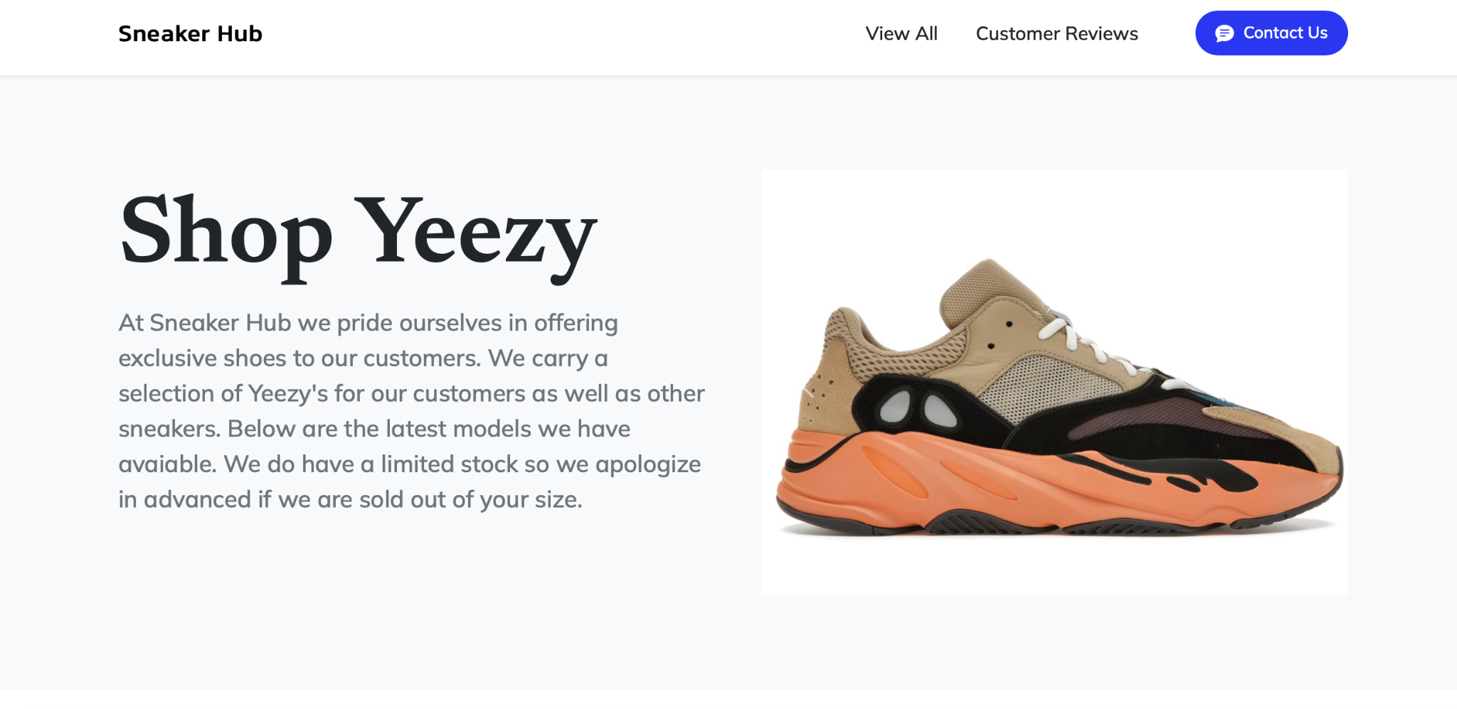
Demonstration:
This is what our website looks like. As you can see we placed our business objective at the top as well as a carousel of images that showcase what we have available.

Slide 5
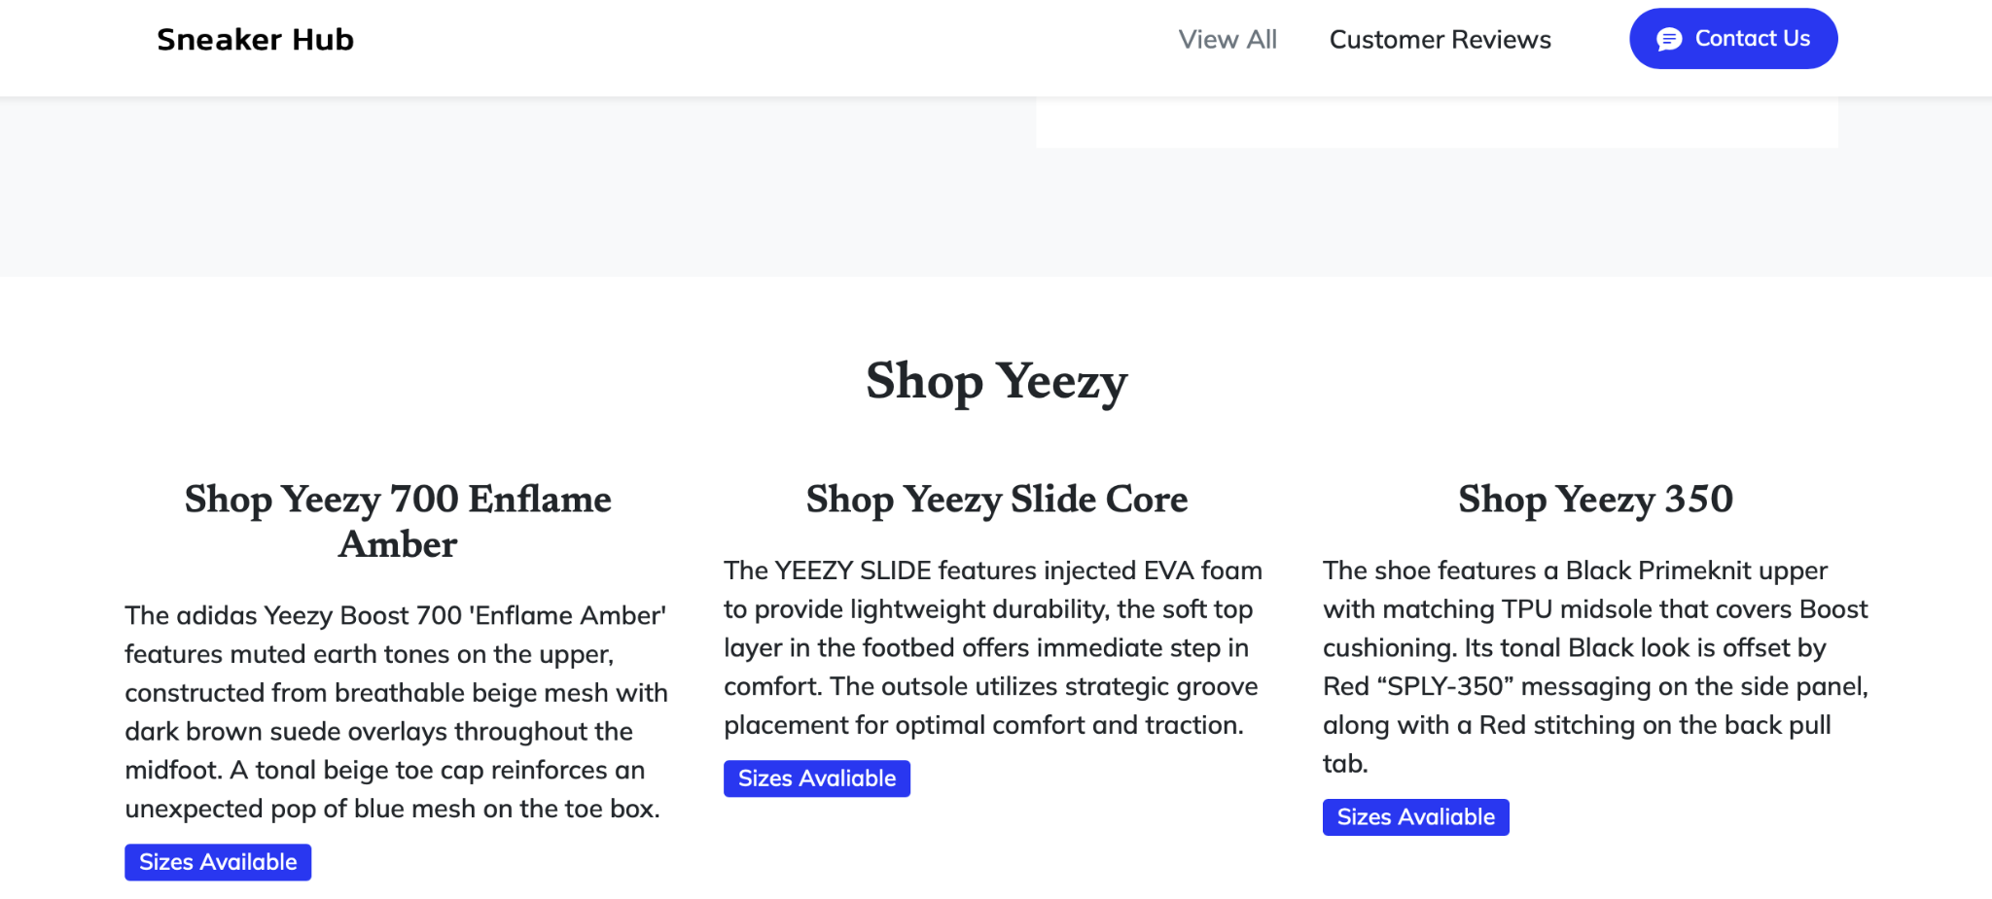
Demonstration:
Under the main part/top part of the page we have a view all tab that when clicked takes you to the portion of the website with descriptions of all the shoes.
Under the sizes Available we have listed sizes we have.

Slide 6
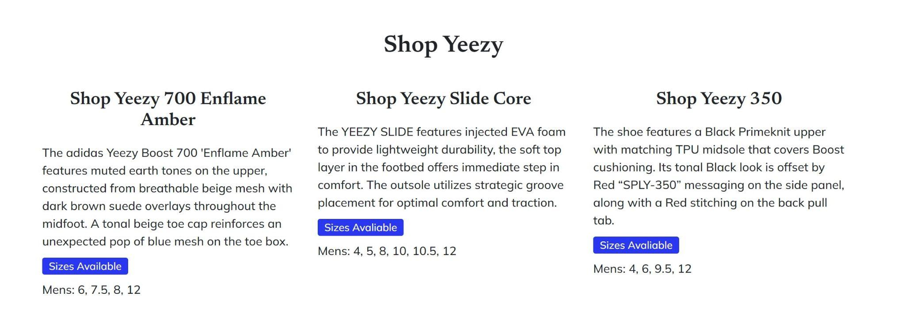
Challenges
Our main challenges were structuring the website and organizing it to look more appealing to the customer.
The sizes could have been more organized.
We had challenges trying to figure out how to just show the selected shoe sizes, instead of all of them.
Notes:
As seen on the picture on the right and which you will see later, the sizes seemed disorganized and not appealing to the customer.
We had an issue trying to display only the sizes for the shoe selected, instead when the you click on the sizes available for one shoe, it will show all the sizes.

Slide 7
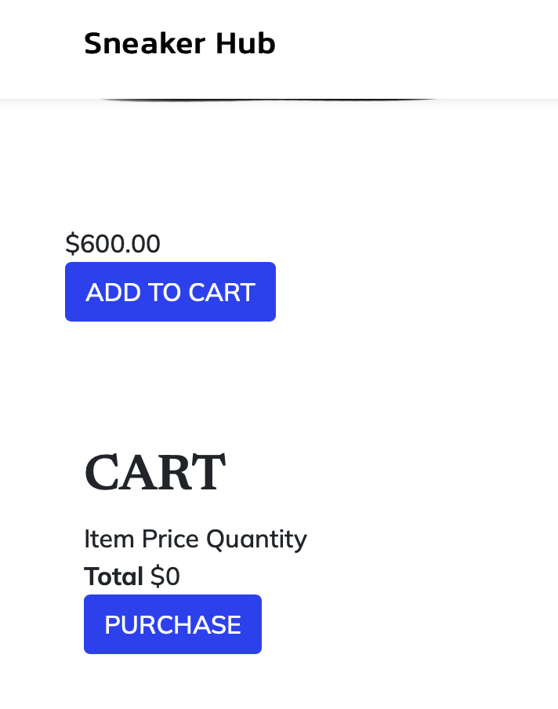
Challenges
Another challenge we had was making the cart show up to the side like as seen on most websites.
You will be able to see this when we show you the website.
Notes:
The shopping cart was another challenge, as we were not able to adjust the shopping cart to be viewed like most websites have them.

Slide 8
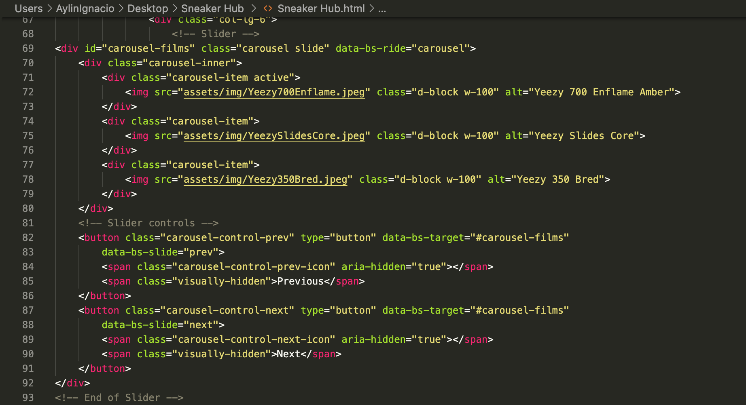
Specifics
As you can see here we implemented a carousel of images to be displayed.

Slide 9
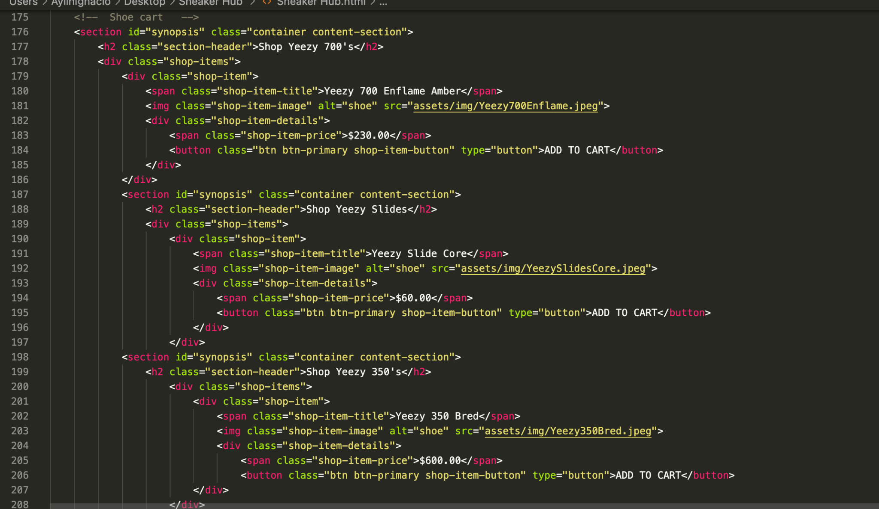
Specifics
Notes:
So we also added buttons like the add to cart and had the price show up for the user to interact with.

Slide 10
Website Presentation

Slide 11

Thank you!

